Slide 1



Topographic Mapping:
Providing Geospatial Decision Support for Louisiana
Dr. James E. Mitchell, Ph. D.
Kurt L. Johnson
Doug B. Albert
Sean P. Deinert
Louisiana Department of Transportation and Development
A Presentation to the Louisiana Coastal Protection and Restoration Authority
March 25, 2014

Slide 2
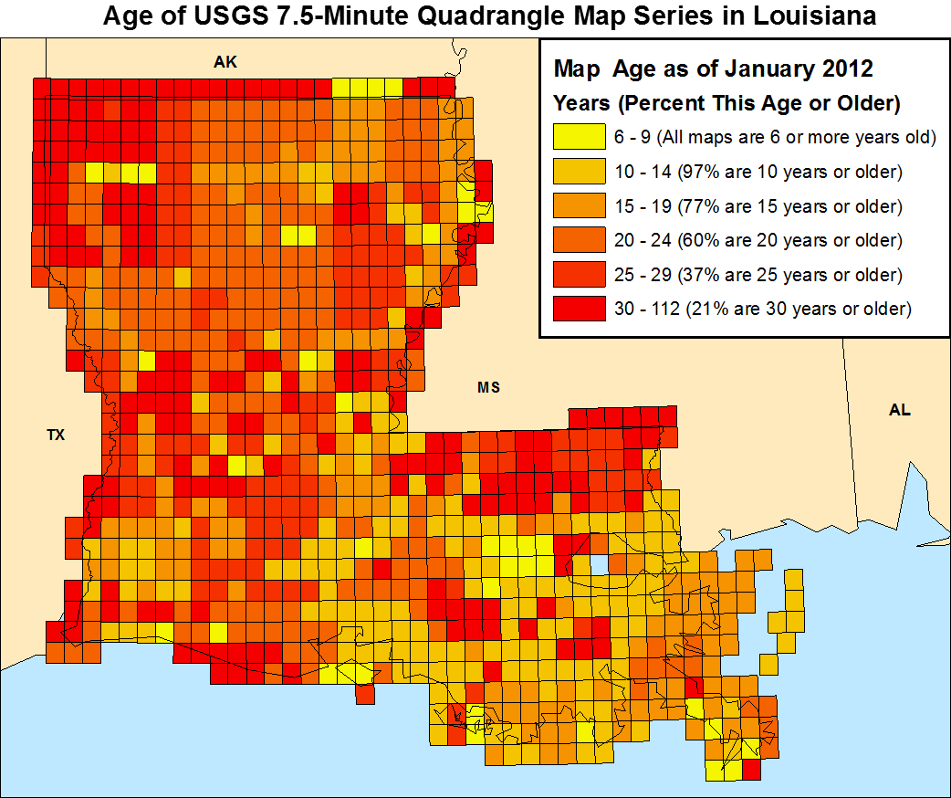

Slide 3
How Up To Date are Louisiana’s Maps?
99% of paper maps are 10 years or older
84% of paper maps are 15 years or older
69% of paper maps are 20 years or older
43% of paper maps are 25 years or older
The Catahoula Quad is 114 years old!

Slide 4
Why Paper Maps Have Fallen Flat…
New Data collection takes time
Map production takes time
Updating is outpaced by real change
One-at-a-time updating leads to temporal and spatial inconsistencies
Benefits are wiped out by the costs of the updates
Notes:
Cartographic production methods create:
>Static maps
>Maps that do not “edge-match,” so features break along map boundaries
>Adjacent maps that can be produced from data of different time periods
>Maps with multiple themes that are not “contemporaneous” because they are produced from data collected at different times. This destroys vertical integration and creates inaccuracies and confusion, such as:
>>>Some maps show land surface elevation contours within water features
>>>Missing features or features on the map that no longer exist
>It is too expensive to update large numbers of paper maps

Slide 5
Paper Map Characteristics
Cartographic Representation | Fixed. Data interpreted by a cartographer for presentation at a single scale.
Boundary | Designed to a particular presentation and ends at an edge. Creates edge-matching issues. Paper maps don’t match because of thematic and temporal differences.
Content | Fixed. Contents cannot change with time or be varied by the user for their purpose. Updating requires complete reproduction. Map revisions are not always vertically integrated.
Presentation | Fixed. Only information presented on the map is available through symbology and labeling. No additional information is available to the user. What you see is what you get. – WYSIWYG.
Storage and Retrieval | Take up a large volume of physical space. Susceptible to damage and deterioration. Retrieval requires physical location, removal, and transport of the media.
Field Use | Does not require electricity. Can be easily marked up. Can be weather-proofed.

Slide 6
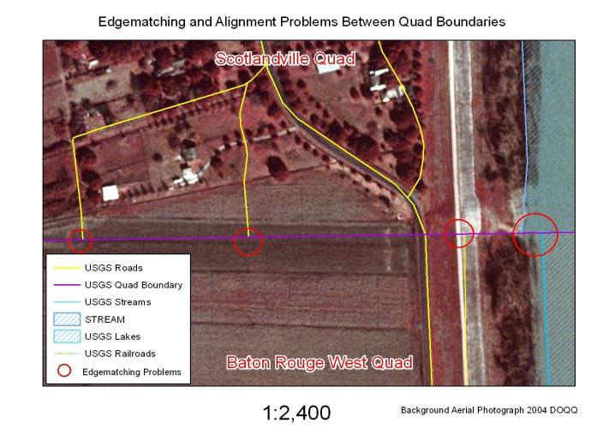
Paper Maps Do Not Edgematch
As lines cross map boundaries they do not meet their counterpart on the next map.

Slide 7
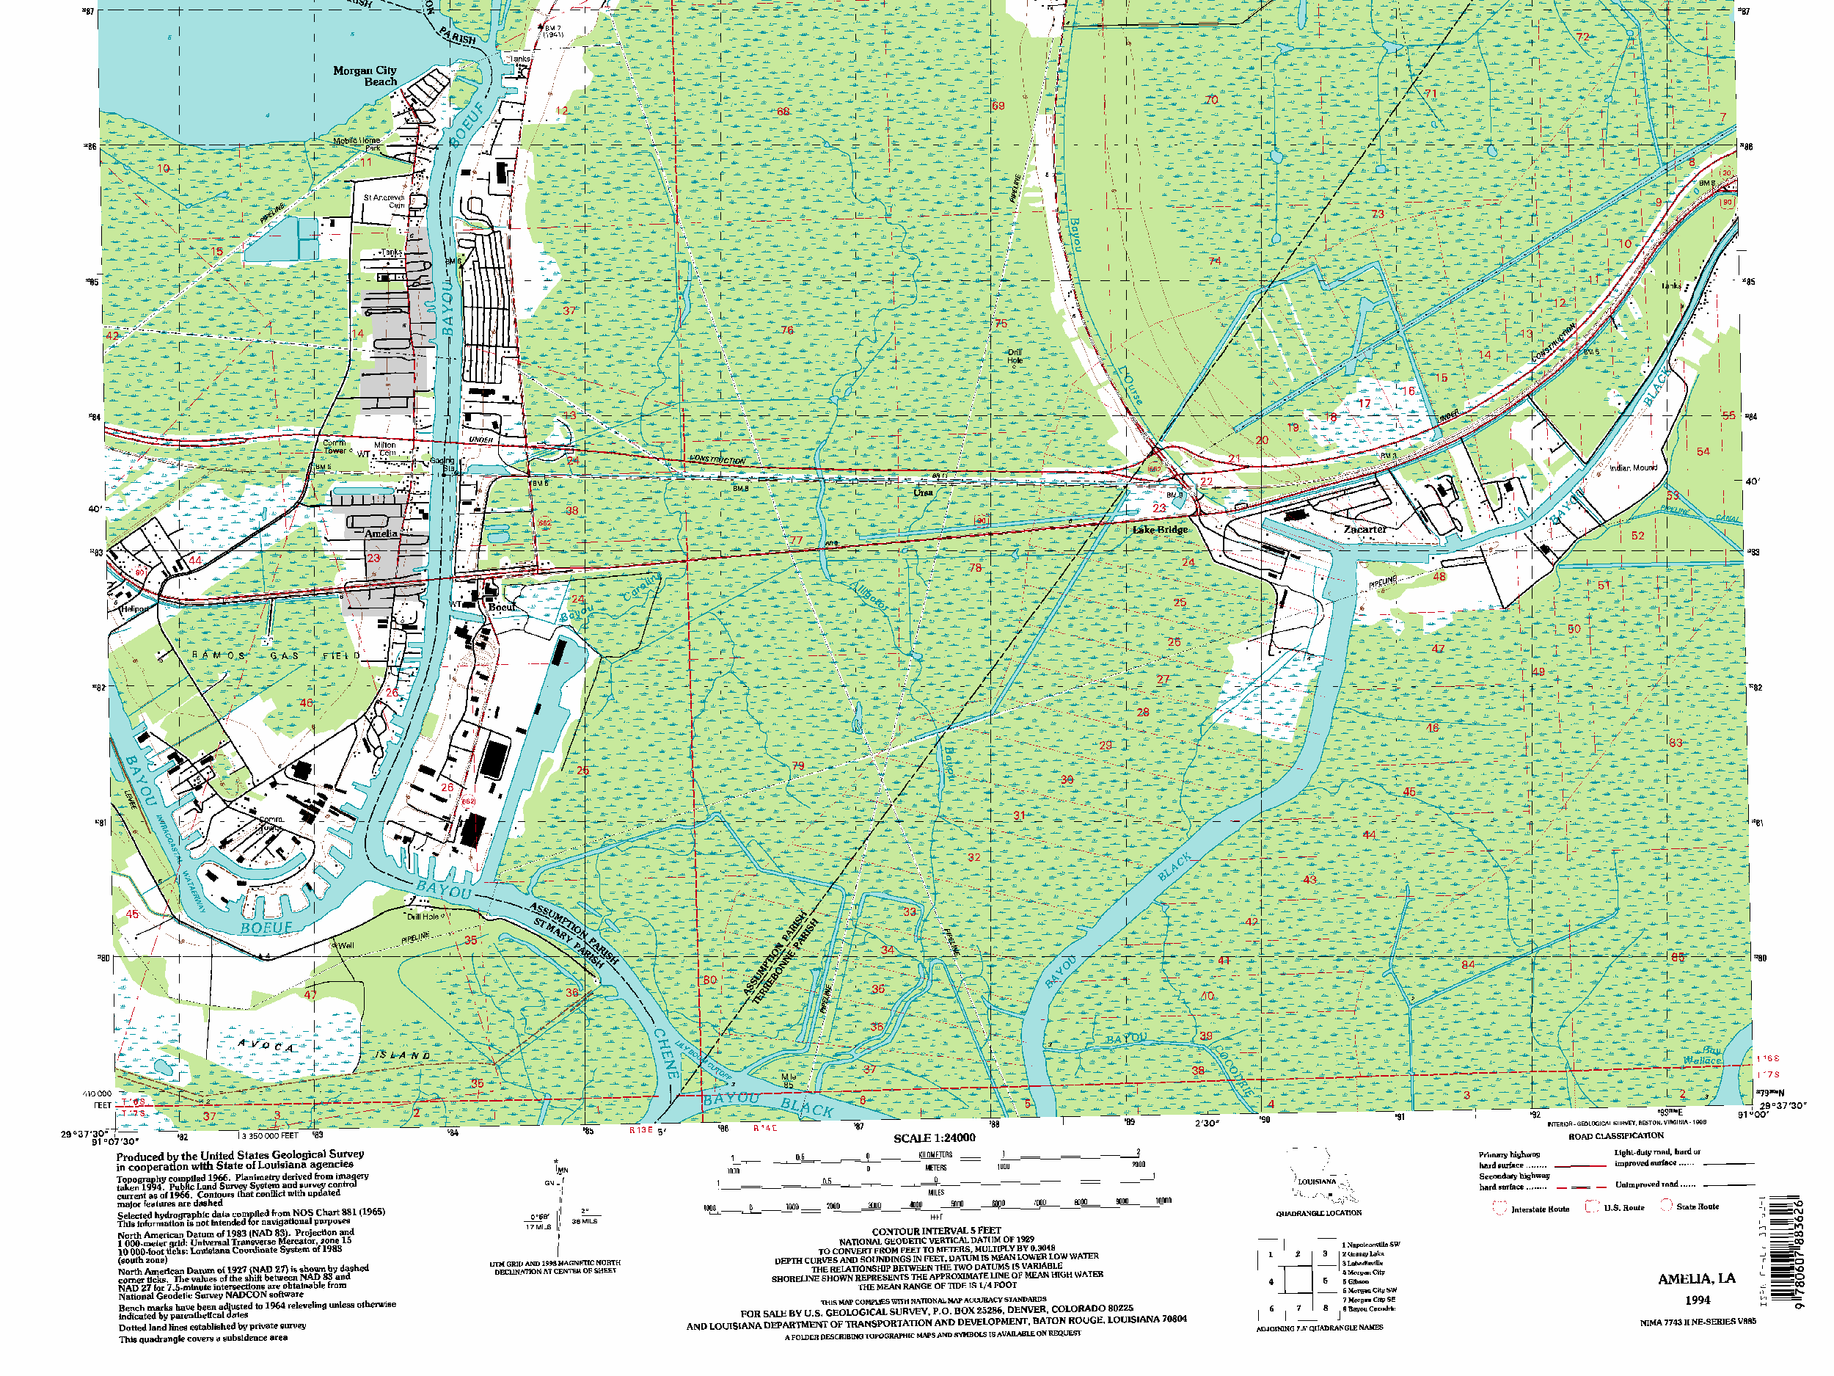
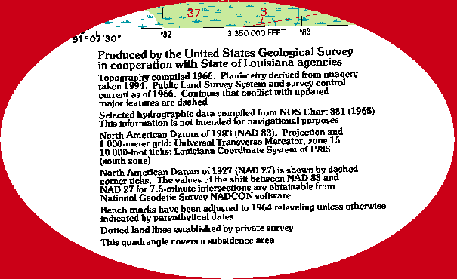

Notes:
Dates are deceiving. Though the “publication” date on this quad (and many others nationwide) is shown as 1994, a look for additional information in the left hand side of the quad map shows that, in fact, though the quad was “revised” in 1994, it maintained most of it’s previous data. The Topography is from 1966, PLSS from 1966, Benchmarks from 1964 and “selected” hydrography is from 1965, though we aren’t exactly sure which hydrography that is. Also of note is the disclaimer that the quad resides in a subsidence area, which lends further credence to the concern about using older topography on a “newer” map.

Slide 8
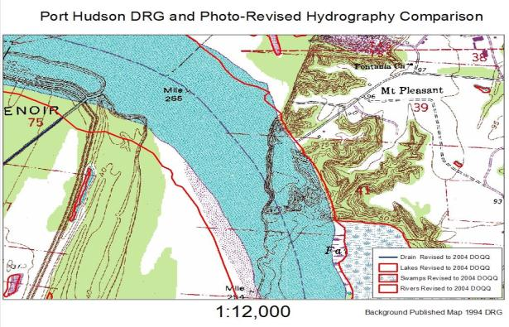
Vertical Disintegration
USGS maps are comprised of seven “framework themes” (water, elevation, transportation, boundaries, benchmarks, vegetation, and structures). USGS did not update all themes contemporaneously. On this map, USGS has not updated the hypsography theme. So, the old elevation contours (brown) lie in the updated water (blue). The thick red lines show the photo-revised shoreline and other water features from the 2004 orthophotos.

Slide 9
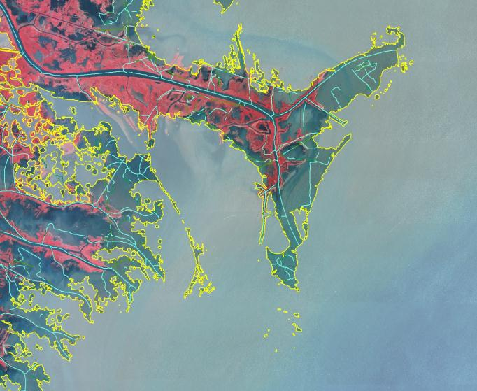
Mapping a Changing Landscape
Notes:
This slide is comprised of 2005 CIR imagery of the “Birds Foot” (MS River Delta) of SE Louisiana, and “current” NHD available from the USGS. As the USGS created the NHD program, it used the “best available” hydrography data to create the hydrographic layer upon which the NHD is based. However, in many cases this data is (even at the time of NHD creation) terribly out of date. The result is “new” digital data, based on old cartographic data, neither of which reflect the current state of the coastal area in Louisiana. Mapping and maintaining this incredibly delicate landscape is one of the primary goals of the Seamless GIS Basemap program, and a task that is vital to the State’s future.

Slide 10
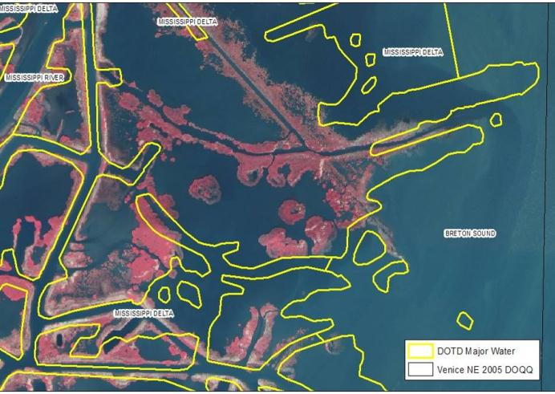
Maps, Data, and Imagery Do Not Match
The yellow lines are where best-available digital data show the land-water boundary. The image is post hurricane orthophotography. Neither match the maps.

Slide 11
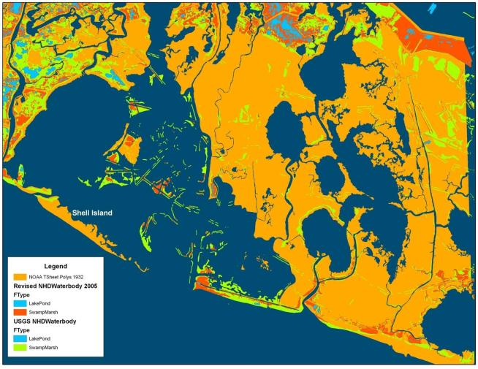
Where Has All The Coastline Gone?
Red features are from the NHD. Orange polygons are areas represented by NOAA as land in 1940 (most current data). These are now open water in the NHD.

Slide 12
History of Mapping in Louisiana
1884 – The USGS establishes the Topographic Mapping Program
1928 – Act 159 of 1928 establishes topographic mapping authority
1939-1940 – US Coast and Geodetic Survey (NOAA) maps Louisiana coastline
2000 – The USGS announces the end of the Topographic Map Program
2002 – The National Map becomes USGS mapping priority
2007 – USGS completed their last map for the State of Louisiana
2007 - The Louisiana Seamless GIS Basemap Project begins with 4 main goals:
  Identify and acquire “best available” digital data from Local, State, and Federal sources
  Assess, revise, and compile sources into a Seamless Geodatabase
  Update National Hydrography Dataset based on watersheds
  Create Louisiana Topographic Maps from geospatial data to replace discontinued USGS topo maps
2010 – Act 782 of 2010 establishes La. R. S. 48:36 Topographic Mapping
2012 – Act 409 of 2012 amended La. R. S. 48:36

Slide 13
La. R. S. 48:36 Topographic Mapping
DOTD shall develop and maintain a statewide digital geospatial database
DOTD shall act as authority for geographic names
DOTD shall set standards for the mapping of topographic features
DOTD shall plan and manage data collection for incorporation into a statewide database
DOTD shall promulgate rules and regulations… as are necessary for the planning and managing of the geospatial data. (LAC 70:XXIX, Chapter 1, page 269)

Slide 14
Topographic Mapping Mission
Support the geospatial information and technology requirements of LADOTD, Louisiana, and all other GIS users
Establish and implement geospatial data standards, provide data access, management, and distribution
Meet the “AAAAA” Data Standard
      Accurate
      Authoritative
      Actionable
      Accessible
      Affordable

Slide 15
The “AAAAA” Standard
 | Factor | Contribution to Data Quality
 | Accurate | The data adequately represents the state of the world in space and time. Locations have sufficient precision for their scale of use and data are current.
 | Authoritative | The source of the data provides sufficient quality control to ensure its veracity and reliability.
 | Actionable | The data are well documented with metadata, require little further assessment or manipulation, and can be put to immediate use.
 | Accessible | The data are discoverable and available through direct download or Service Oriented Architecture (SOA). Data can be searched directly, selected, and accessed without intervention by its provider.
 | Affordable | The data can be accessed with little or no cost to the user.

Slide 16
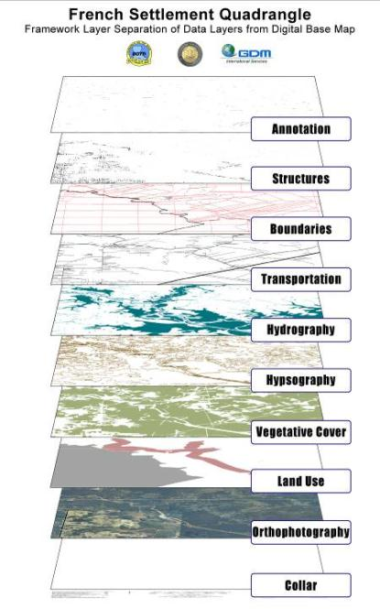
Traditional Data Sources
New Digital
Database Format
GNIS, Local Data
USGS Quads, DOQQ
Annotation
BLM, Census, State Data
Structures
Boundaries
Census, State Data
Transportation
USGS NHD
Hydrography
Contours
LiDAR
Vegetation
Orthophotography
Land Use
BLM, Census, State Data

Slide 17
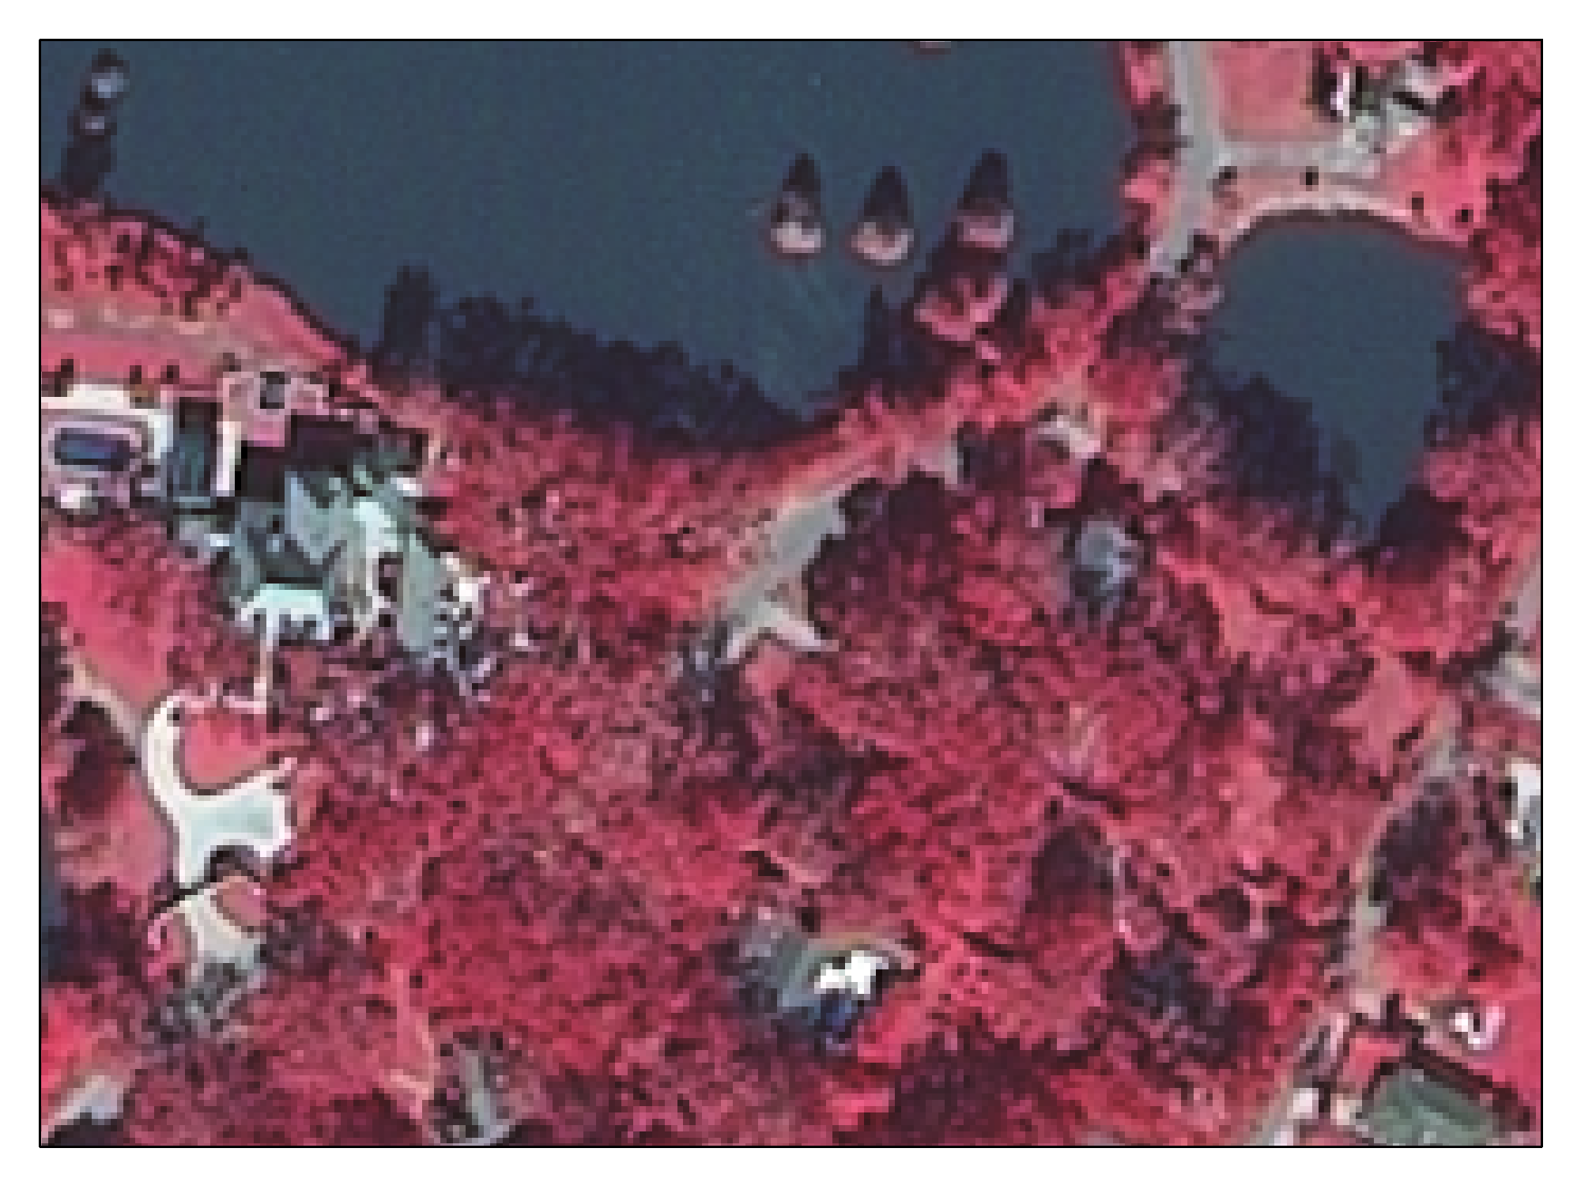
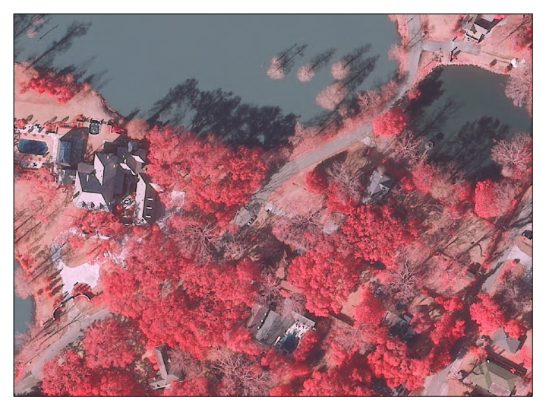
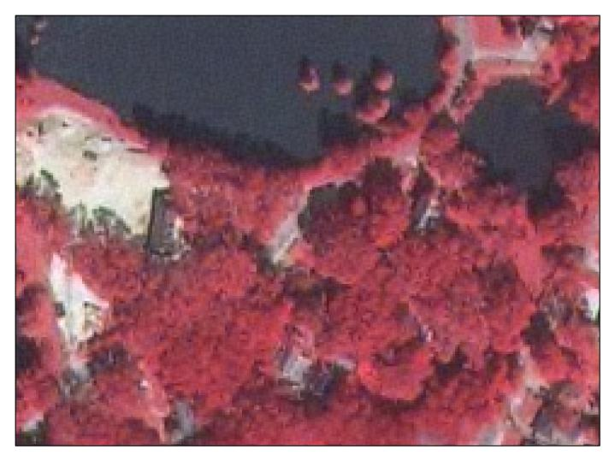
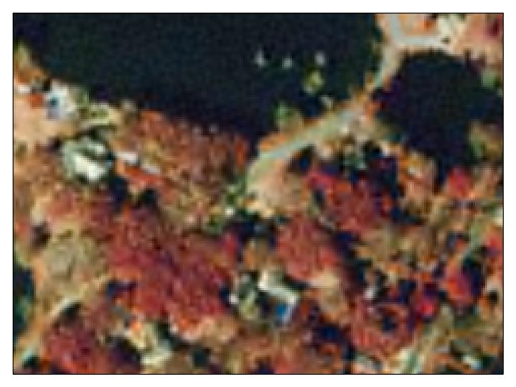
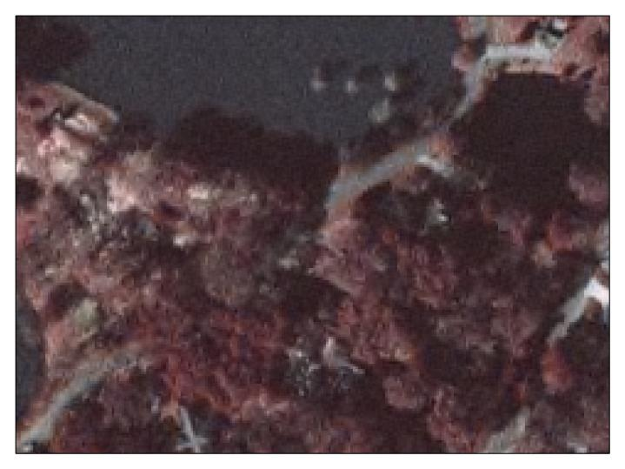
Improvements in Source Data
1:1,000 scale
Lakeshore Drive, Baton Rouge 1998
Lakeshore Drive, Baton Rouge 2004
Lakeshore Drive, Baton Rouge 2005
Lakeshore Drive, Baton Rouge 2008
Lakeshore Drive, Baton Rouge 2010

Slide 18
Digital Map Characteristics
Cartographic Representation | GIS data are stored as actual geographic features, but can be placed on the map using various cartographic representations, based on scale.
Boundary | Digital maps can utilize actual, surveyed, legal boundary data. The data are seamless and represent the boundary and the area it contains, regardless of the map extent.
Content | Dynamic. Digital maps can contain much more information than is displayed. All the information remains in the data, available to the user for searches, alternate presentations, and geoprocessing.
Presentation | Dynamic. Multiple data fields can be used to represent data in different ways, at the user’s discretion. Digital maps can be stored and presented via different mediums: print, web maps, mobile devices, etc.
Storage and Retrieval | An entire atlas can be stored on a thumb drive. A single geodatabase can contain all map elements and can provide them seamlessly to anyone. Data are searchable and can be transported electronically.
Field Use | Data can be brought into the field on mobile devices or pushed to remote users over a network or wirelessly. User maintains access to the data and their GIS tools to use it.

Slide 19
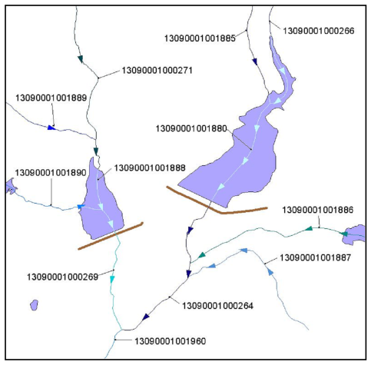
National Hydrography Dataset
Notes:
The National Hydrography Dataset is a USGS product which allows for flow modeling of hydrologic data. The NHD also maintains historical data of flow patterns and features via “reachcodes” which are unique identifiers to name flow paths nationwide. The ability to model flow patterns has many applicable uses, including flood mapping and planning, and environmental applications.

Slide 20
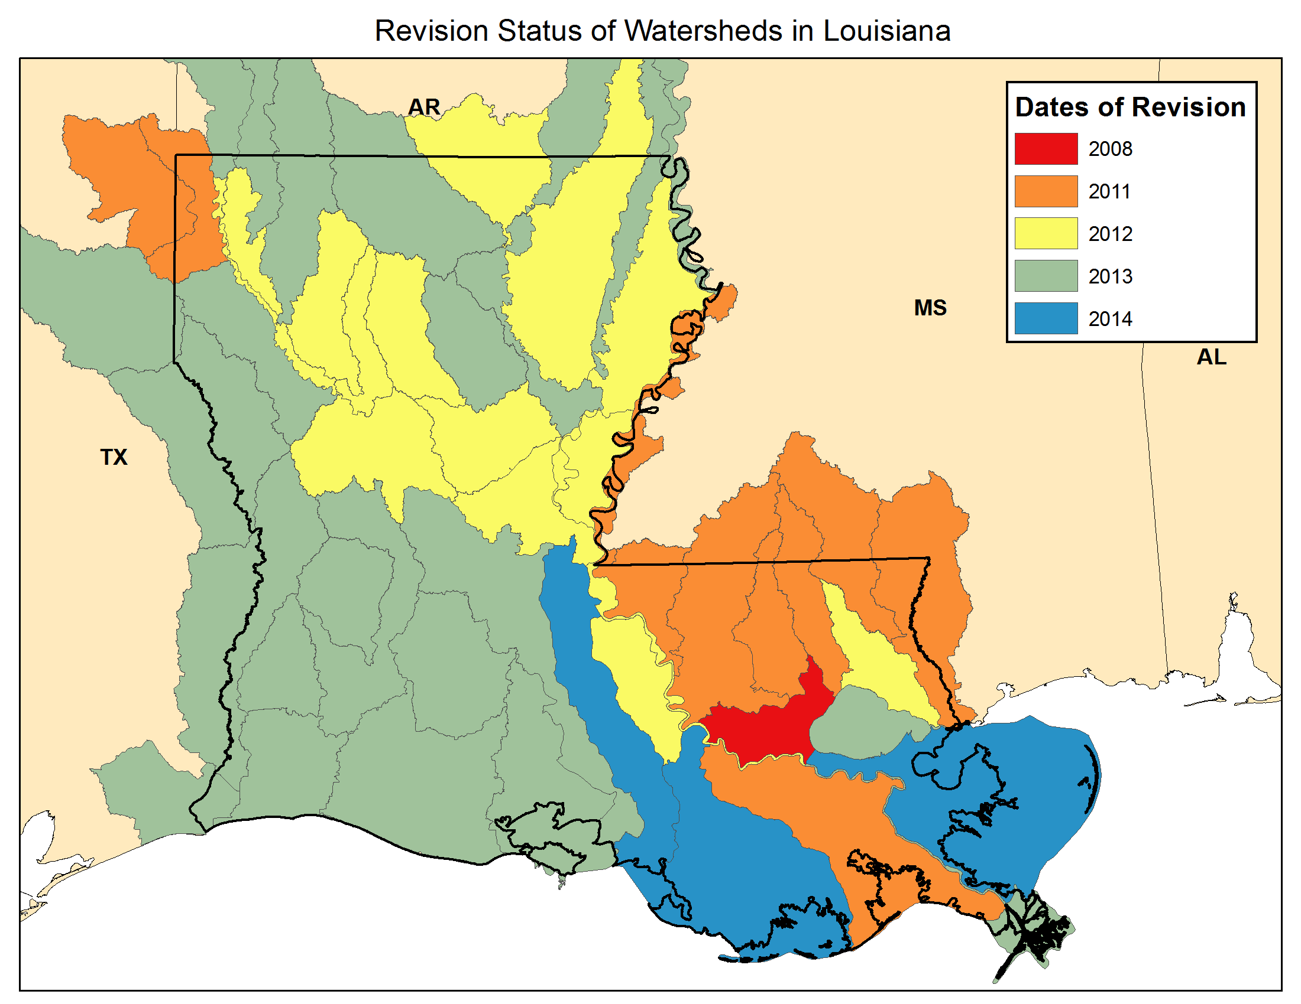

Slide 21
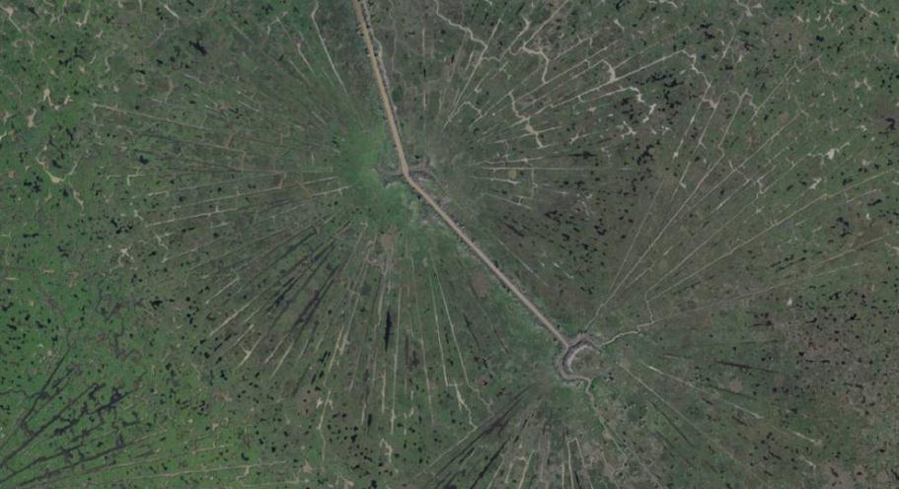
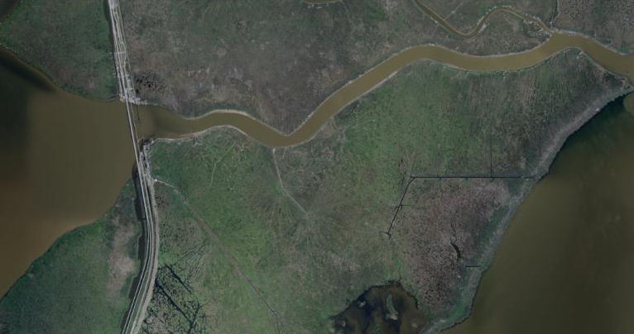
Lake Maurepas
First “Coastal Louisiana” experience – Pass Manchac

Slide 22
Photorevision Overestimates Land
Redfish
Bay

Slide 23
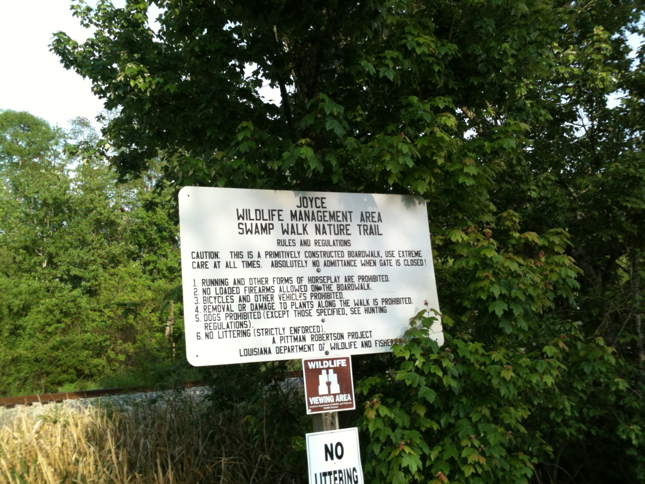
Joyce Wildlife Management Area
Swamp Walk Nature Trail
Redfish
Bay

Slide 24
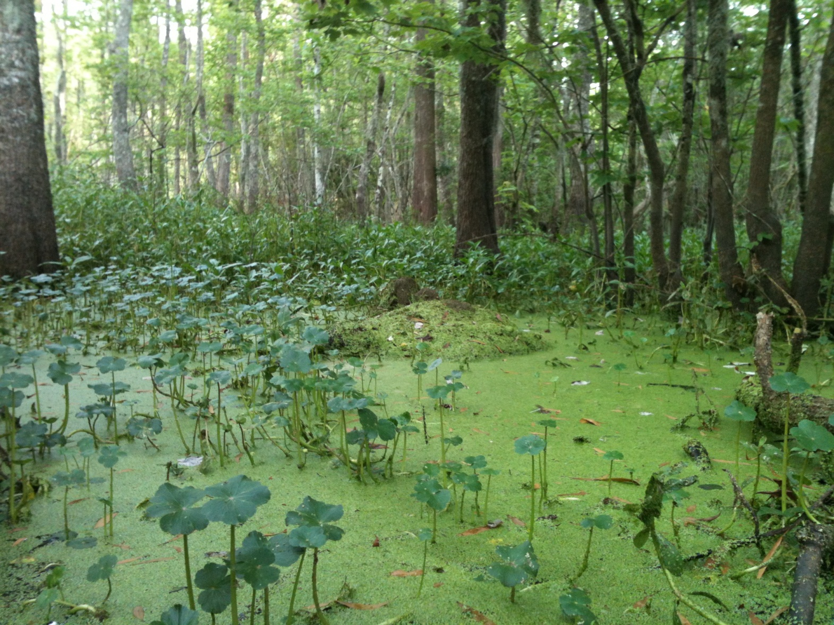
Duck Weed Choked “Open” Area Along the Boardwalk
Redfish
Bay
The forest floor is inundated, under a constant level of water. This is a contiguous waterbody, blow the forest canopy.

Slide 25
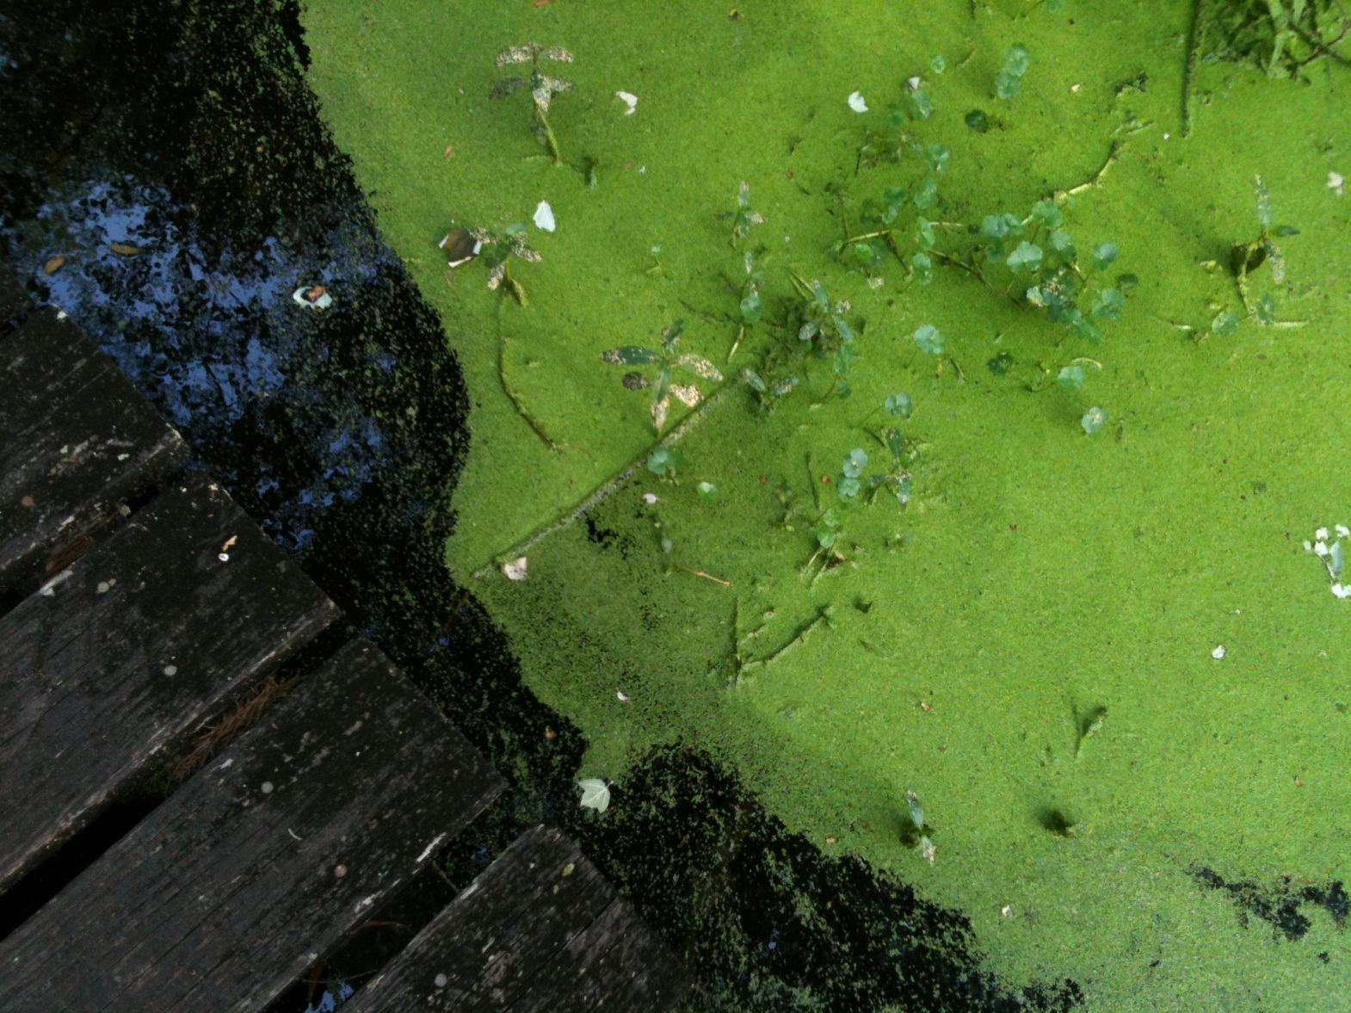
The Swamp is Alive with Plants and Animals All Living in the Water
Redfish
Bay
At the time of this photo, in late March, water is slowly flowing from north to south.

Slide 26
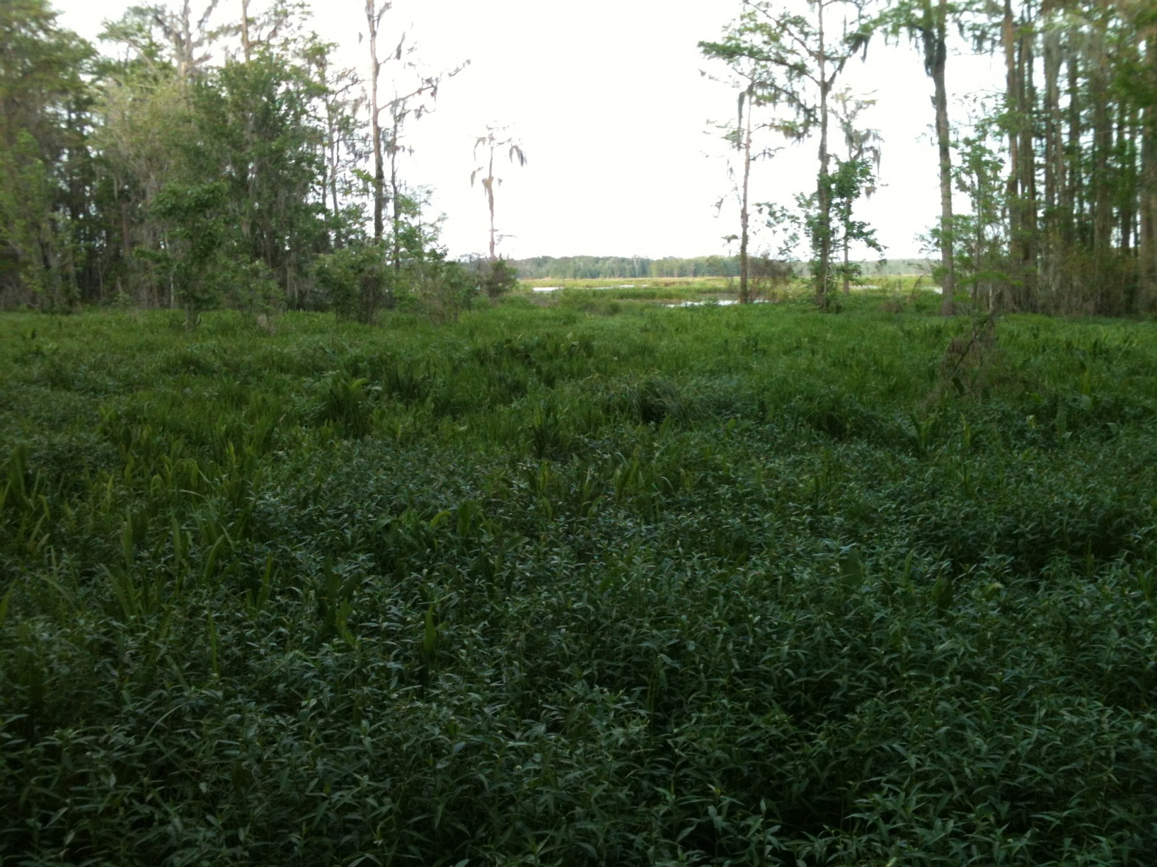
At the End of the Boardwalk
Looking East-northeast
Redfish
Bay
The early spring vegetation is very overgrown and the underlying water is not apparent. This location is almost 12 miles from the shore of Lake Pontchartrain.

Slide 27
Photorevision Overestimates Land
Redfish
Bay

Slide 28
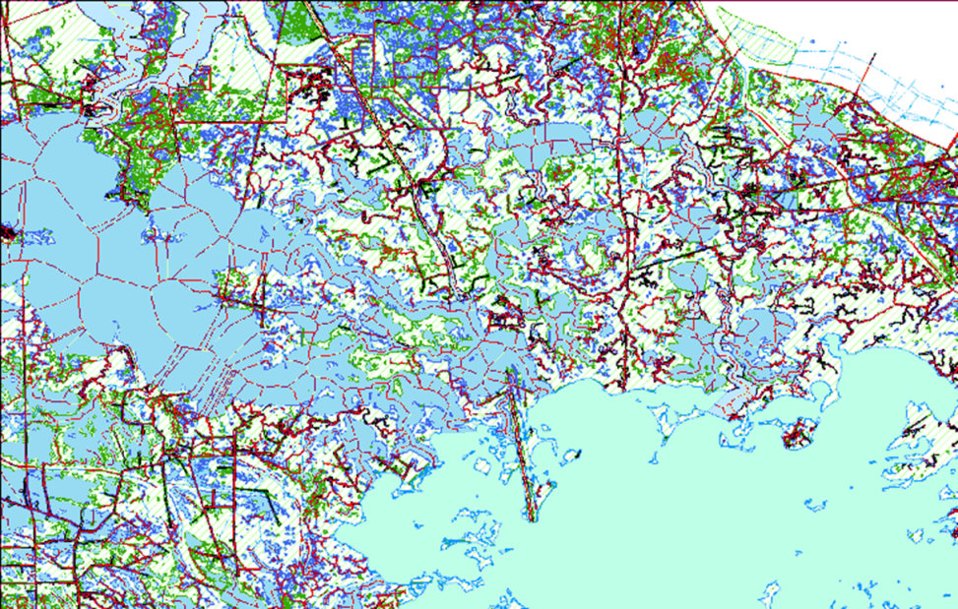
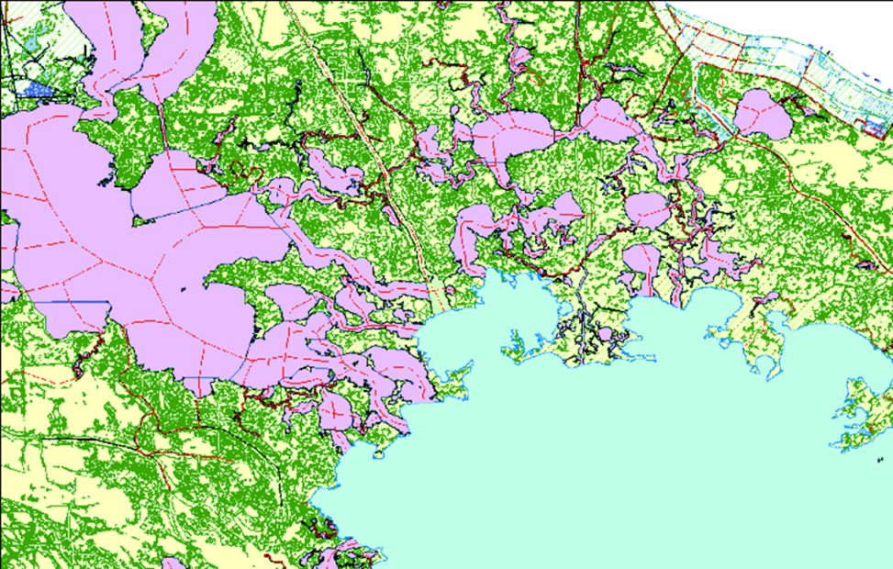
Developing New Procedures for National Hydrography Dataset Coastal Mapping
Old Procedure:
60,000+ Features
8+ Months to Revise
Manual Attribute Tracking
New Procedure:
~31,000 Features
5 Months to Revise
Automated Attribute Tracking

Slide 29
Why Is Louisiana’s Geospatial Data So Difficult to Keep Up to Date?
Louisiana is largely in the Mississippi River Delta
  One of the most active deltaic systems in the world
  Deltaic geology is inherently unstable
  The Birdsfoot Delta juts far into the Gulf of Mexico
  All of these factors combine to make coastal Louisiana susceptible to hurricane and tropical storm damage
Subsidence
  Anisotropic and heterogeneous effects of subsidence create a response that is spatially dispersed and inconsistent across the landscape
Sea Level Rise
  Compounds all of the above
All of these factors combine to continuously create new geographic features, while changing and destroying old geographic features

Slide 30
Why Decision Makers Need
Up-to-Date Geospatial Data
Geospatial data provide information about where people, infrastructure, commerce, and government services are located and how to connect them
Geospatial data provide a framework for transparency, planning, and delivering services. It promotes good government and interaction across all levels of government
Geospatial data provide information essential to plan, promote, and market economic development opportunities
Geospatial data provide a common operational picture (COP) for emergency mitigation, preparation, and response

Slide 31
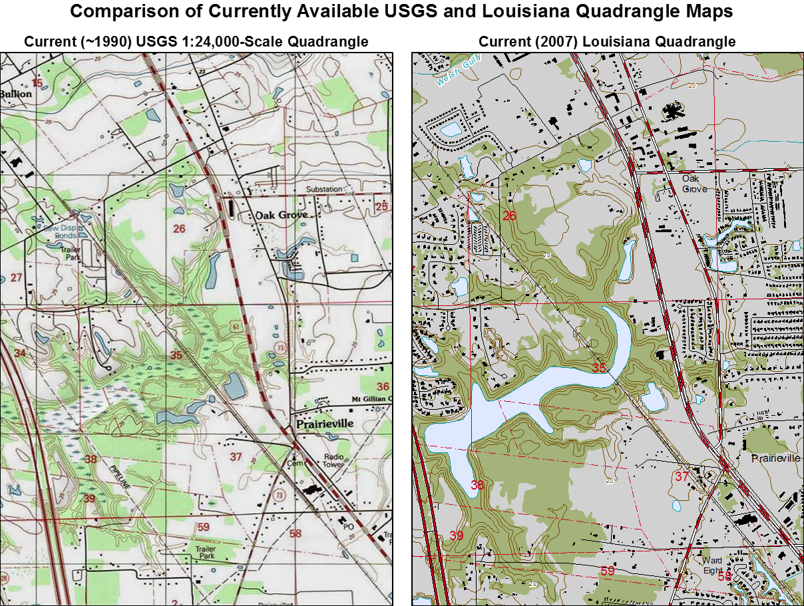
Would you make a decision based on a 30-year old map?

Slide 32
Lake Pontchartrain Basin Flow Diagram
Maps and diagrams are linked. The schematic depiction of these basins provides a clear view of their topology

Slide 33
Flow Topology Applications
Connecting Upstream and Downstream
Schematic diagrams can be “traced” and selections propagated into the data frame

Slide 34
Where Has All The Coastline Gone?
Red features are from the NHD. Orange polygons are areas represented by NOAA as land in 1940 (most current data). These are now open water in the NHD.

Slide 35
Shell Island Area on the USGS Quad

Slide 36
Shell Island Area Revised

Slide 37
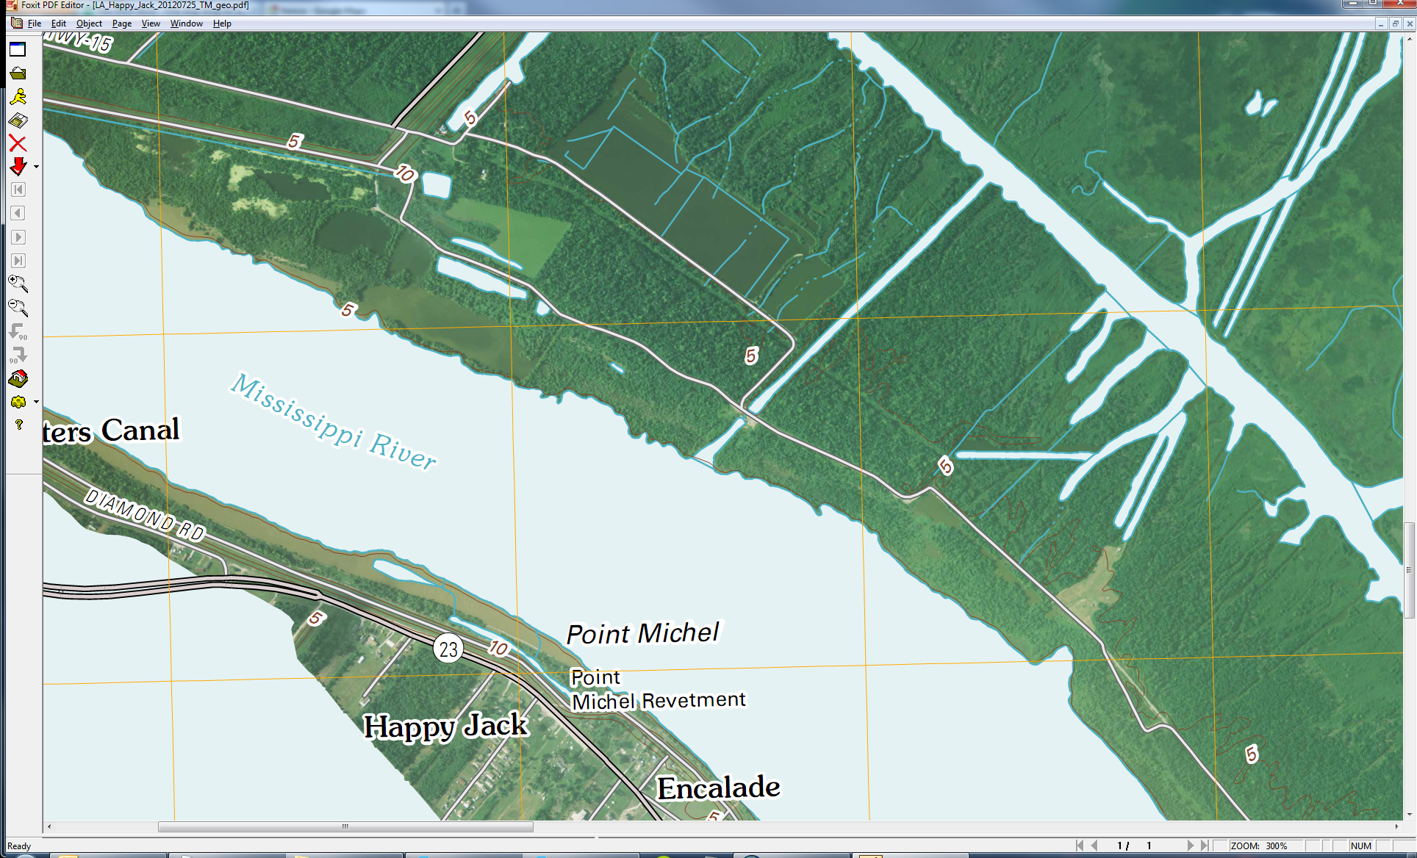
Mardi Gras Pass – Digital US Topo (2012)
Topo indicates imagery date of May, 2010

Slide 38
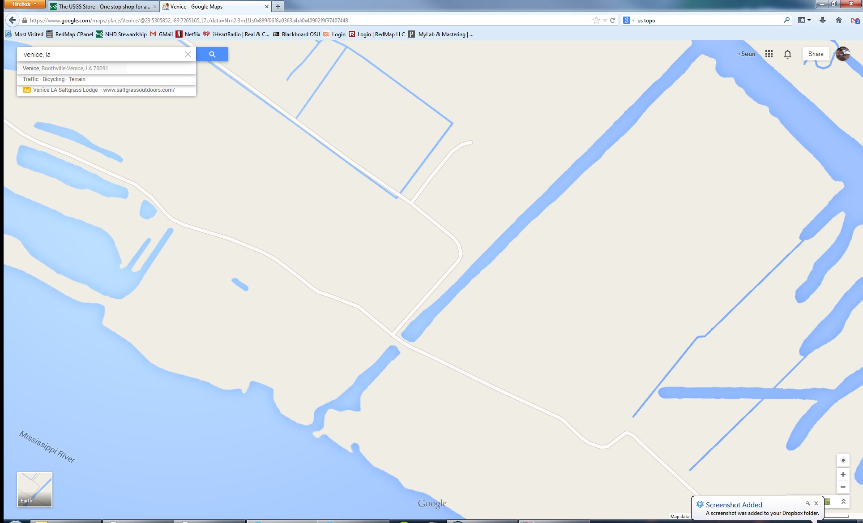
Mardi Gras Pass – Google Maps

Slide 39
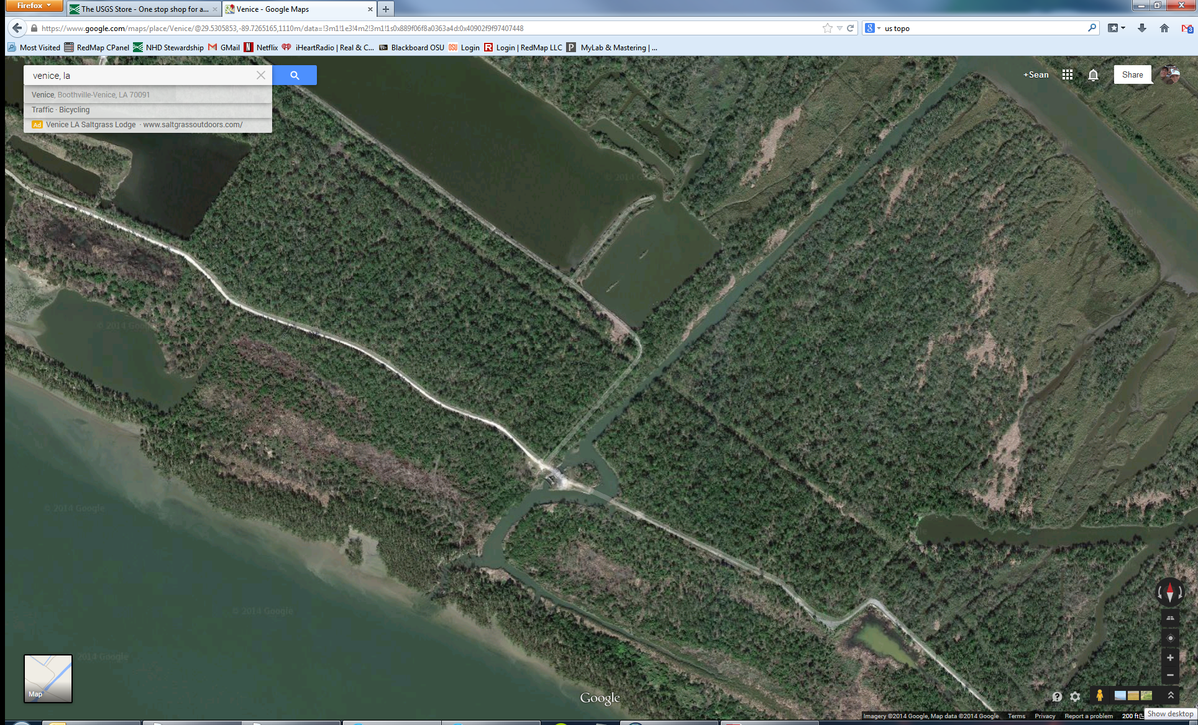
Mardi Gras Pass – Google Maps (2014)

Slide 40
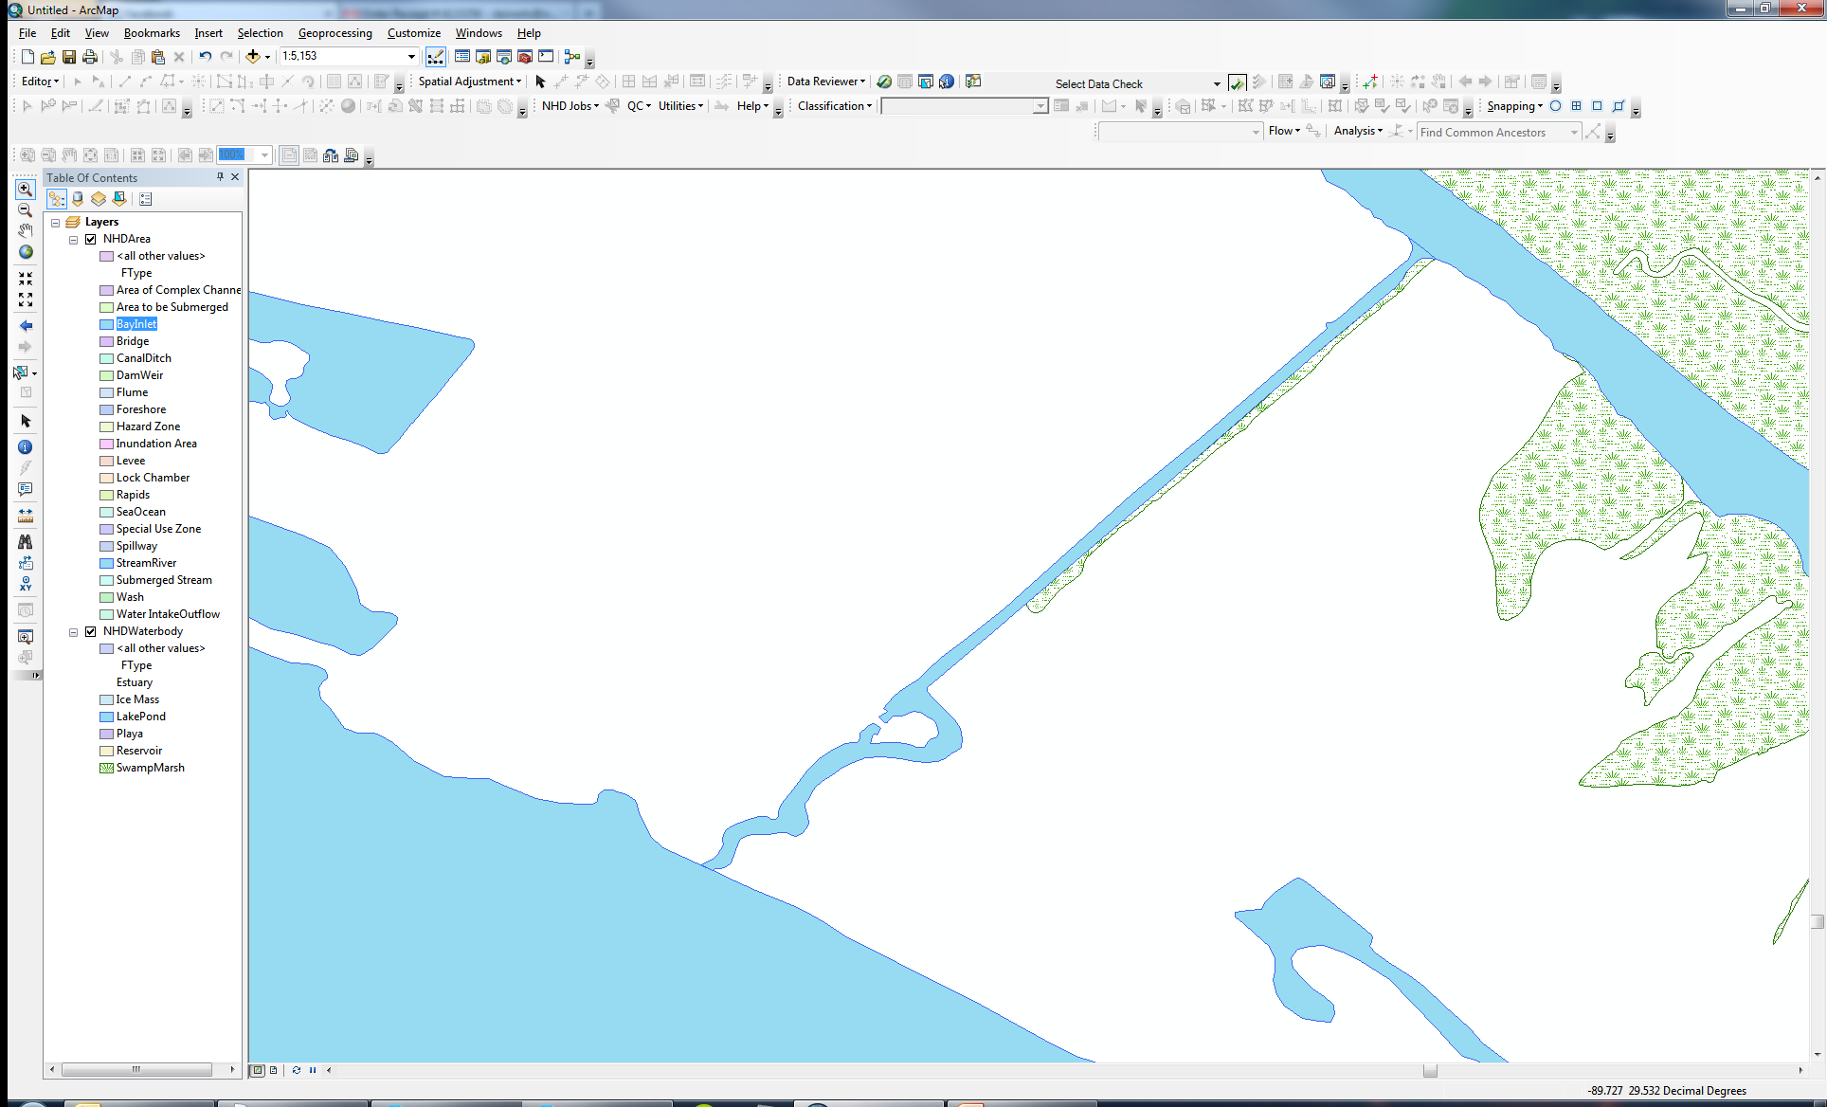
Mardi Gras Pass – DOTD NHD (2014)

